Slide 1



X
QA Engineer Final Project
Jubelio Quality Assurance Engineer Virtual Internship
Presented by
Muhammad Rafi Ediananta

Slide 2

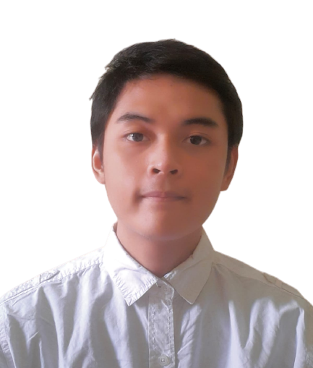
Muhammad Rafi Ediananta
Insert Your Experience
Project-Based Virtual Intern: Jubelio Quality Assurance Engineer Virtual Internship
About You
As a Telecommunication Engineering student, I have gained valuable technical experience and worked collaboratively on various projects. I possess strong leadership skills and a high enthusiasm for learning. My focus lies in the field of technology, particularly in security development and applications, such as web development and ethical hacking. Through my experiences and skills, I have received recognition and held notable positions, including serving as a research assistant at MBC Laboratory. I have also achieved satisfactory academic performance with a GPA of 3.8.
Cybersecurity Research Assistant at Multimedia Application, Big Data, and Cybersecurity Laboratory
Practicum Assistant at Basic Computing Laboratory

Slide 3
Case Study
Buatlah test case pada beberapa fitur di Jubelio:
○ User login Jubelio (Jubelio page)
○ User membuat negative test case pada login Jubelio (Jubelio page)
○ User membuat barang baru non varian pada katalog (Jubelio page)
Lakukan API testing dengan Postman pada Jubelio API:
○ Testing pada endpoint:
■ Login: Jubelio API
■ All product price: Jubelio API
■ Upload product image: Jubelio API
■ Delete product: Jubelio API
○ Lengkapi testing API dengan negative scenario (min 1 pada tiap test)
○ Buatlah test case terkait API test tersebut

Slide 4
Case Study
Buatlah Web Automation dengan Selenium Web Driver
○ Buat automation scenario pada Login flow di halaman Jubelio (Jubelio page)
○ Buat automation scenario untuk mengatur stock persediaan (Jubelio page)
Buatlah Github repository untuk web automation yang telah Anda buat
○ Buat Github account
○ Buat Github repository
○ Upload local code ke remote repository
○ Berikan step by step untuk menjalankan automation yang telah dibuat di local
○ Berikan evidence pendukung (screen record) saat menjalankan web automation tersebut di local
○ Berikan evidence (screenshot) run results (jumlah scenario dan jumlah steps) di local

Slide 5
Link Test Case:
https://rentesting.atlassian.net/l/cp/M2vesZXU

Slide 6
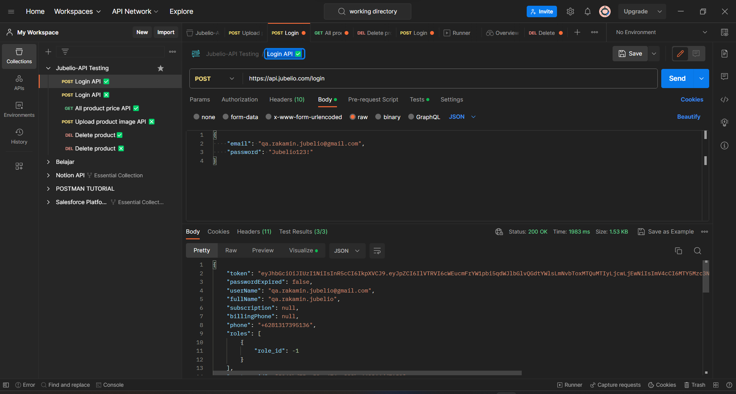

Slide 7
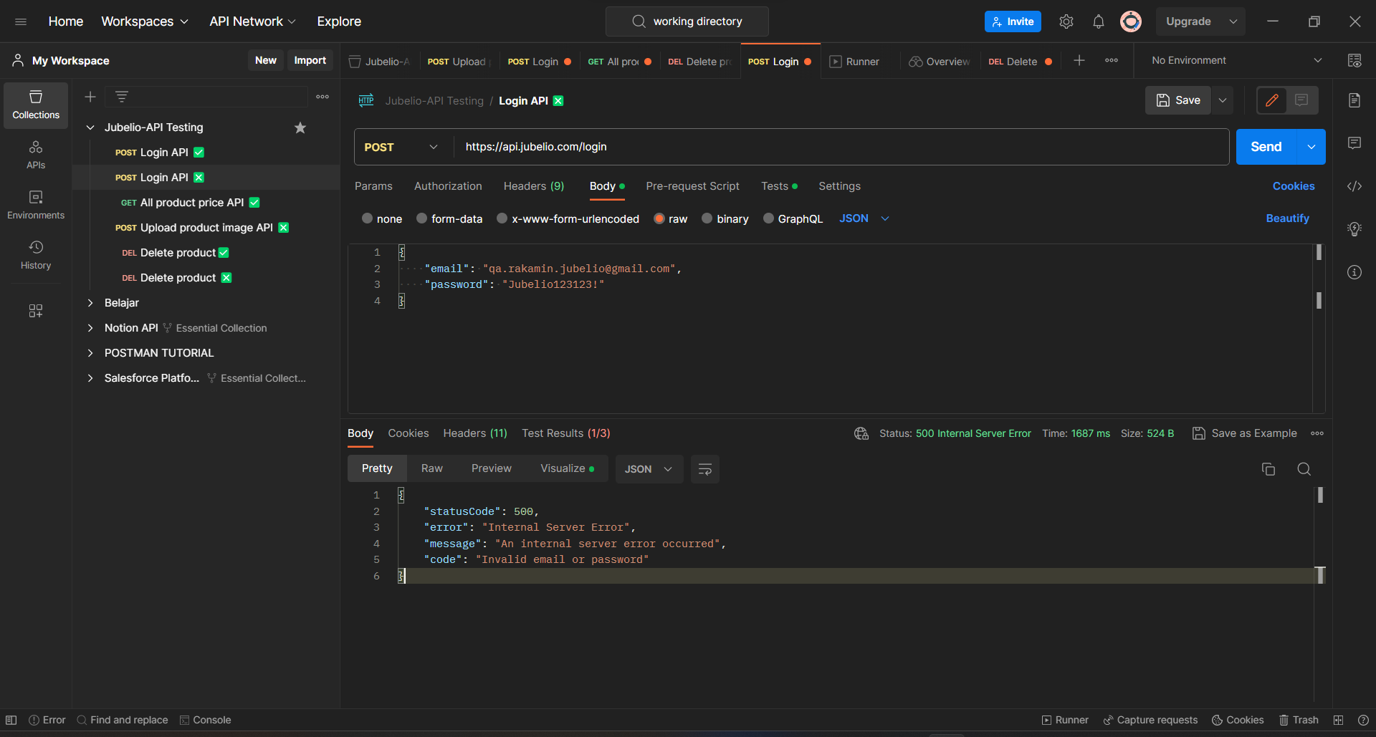

Slide 8
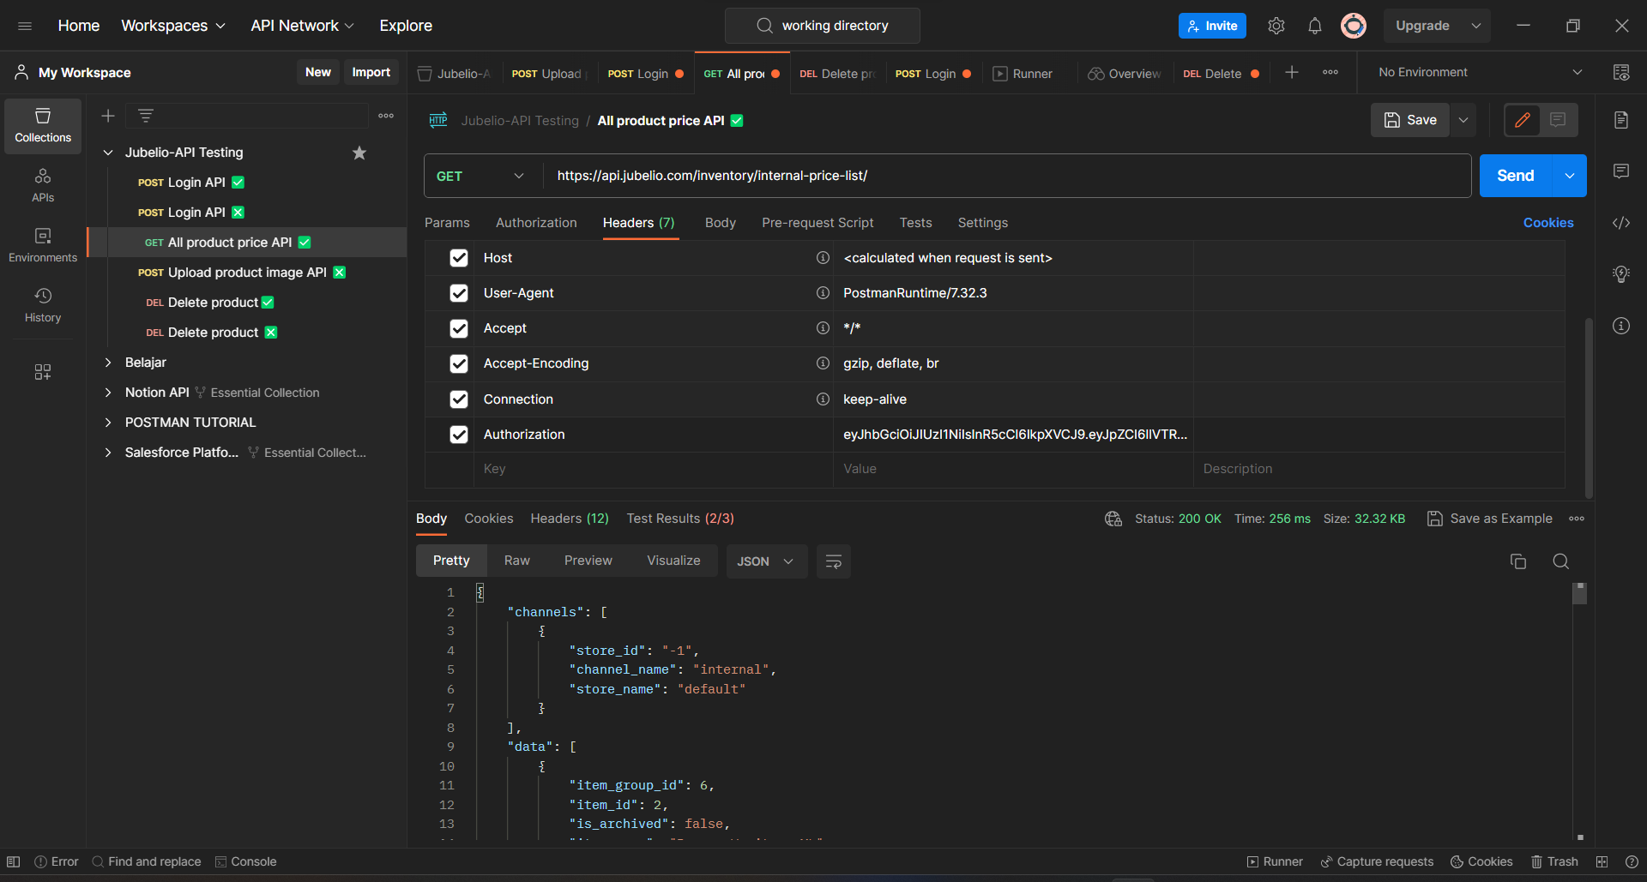

Slide 9
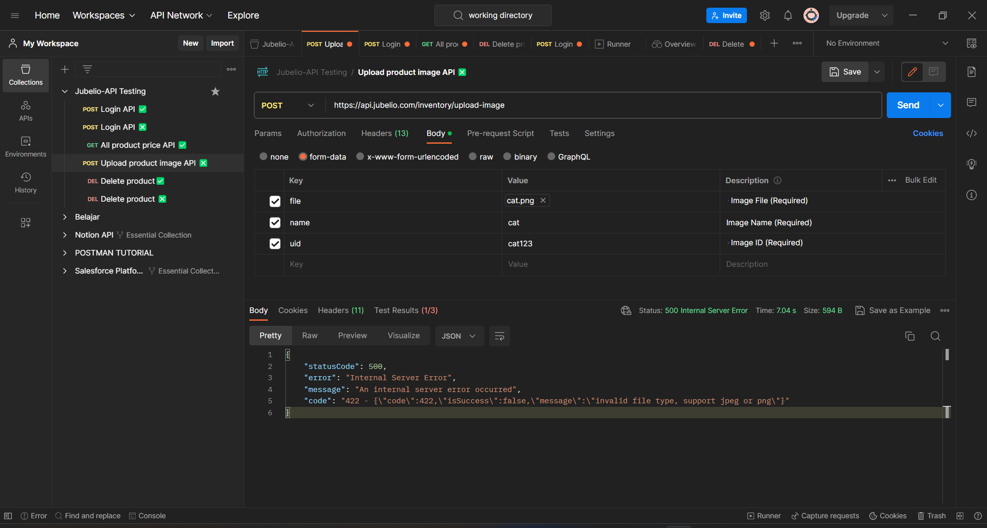

Slide 10
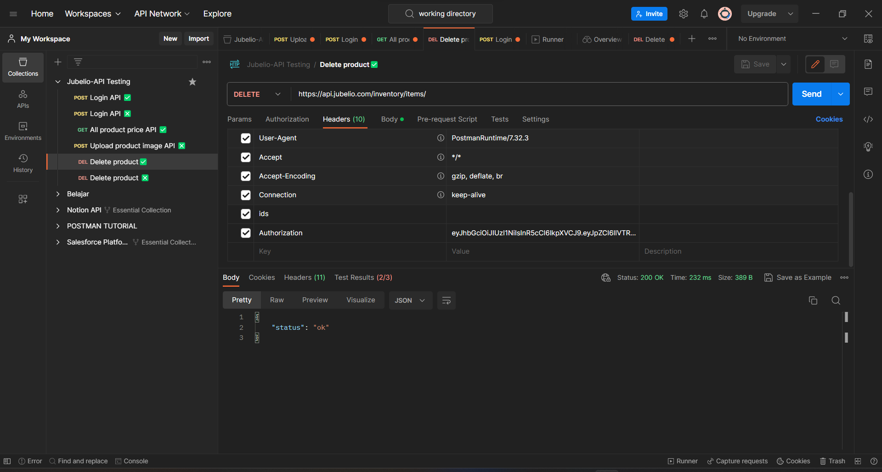

Slide 11
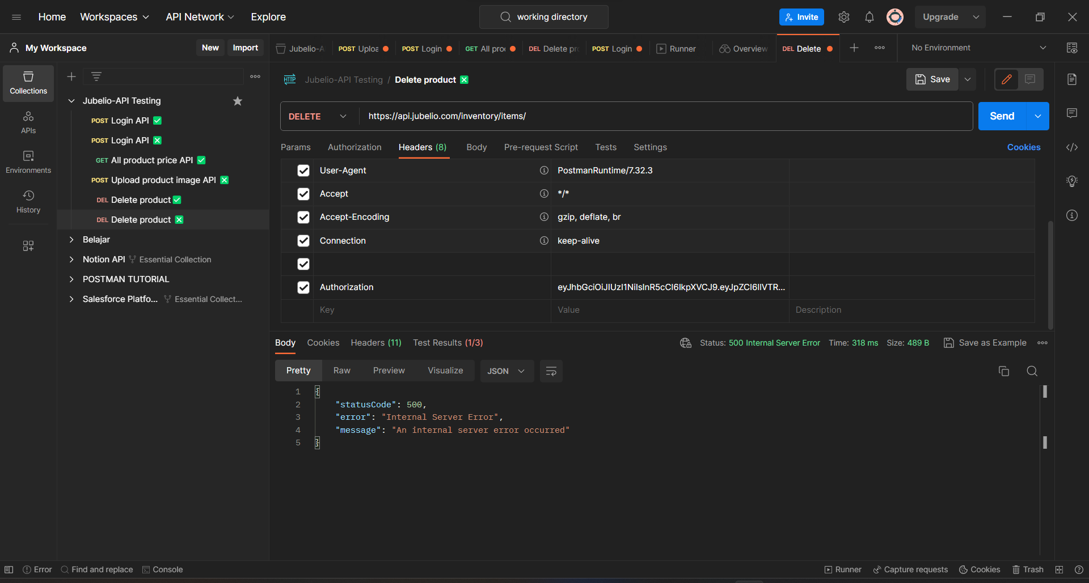

Slide 12
Insert Your Link Github Here
https://github.com/LazyCats07/FinalTask_Jubelio_QA_Muhammad-Rafi-Ediananta---Shortcut

Slide 13
Video Presentation Here
Please insert your link video here (You can upload the video on YouTube or Google Drive first)!

Slide 14
Thank You
X

Slide 15

Disclaimer
Kalian dapat mengganti design template ini sesuai kreativitas kalian.
Template ini hanya bertujuan untuk memberikan gambaran isi konten yang wajib dibuat oleh peserta.

